Slide 1
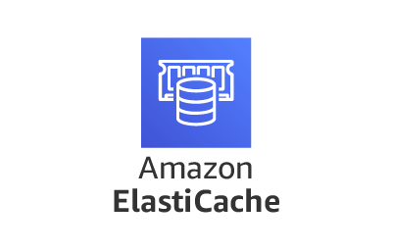

Slide 2

Topics
ElastiCache
ElastiCache Types
Use Case
Database Migration Service
Type of AWS Database Migration Service
Source & Targets in DMS
Exam Tip

Slide 3

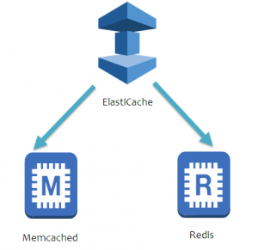
What is ElastiCache?
ElastiCache is web service that makes it easy to deploy, operate and scale an in-memory cache in the cloud.
The service improve the performance of web application by allowing you to retrieve information from fast, managed, in-memory caches, instead of relying entirely on slower disk-based databases
ElastiCache supports two open-source in-memory caching engines.
Memcached
Redis

Slide 4
ElastiCache Types
Memcached
Great for basic Object caching. Scales horizontally, but there is no persistence, Multi-AZ or failover
A good choice if you just want basic caching and you want your caching model to be as simple as possible
Redis
A more sophisticated solution with enterprise features like persistence, replication, Multi-AZ and failover.
Supports sorting and ranking data (e.g., for gaming leaderboards), complex data type like list and hashes

Slide 5
Use Case
Typical Scenario : Database Under Stress , Find a Solution
ElastiCache is a good choice if your database is particularly read-heavy and not prone to frequent changing
Can’t Help
Heavy write loads: Caching will not help alleviate heavy write loads, so you may need to scale up your database
OLAP Queries:
If your database is feeling stress because you are performing Online Analytical Processing. Think about Redshift instead

Slide 6
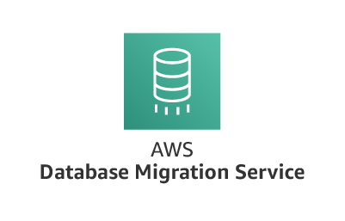

Slide 7
What is AWS Database Migration Service?
It is a cloud service that makes it easy to migrate relational databases, data warehouses, NoSQL databases and other types of data stores.
You can use AWS DMS to migrate your data into the AWS, between on-premises instances (through an AWS setup) or between combinations of cloud and on-premises setups
AWS DMS is a server in the AWS that runs replication software.
You create a source and target connection to tell AWS DMS where to extract from and load to. Then you schedule a task that runs on this server to move your data.

Slide 8
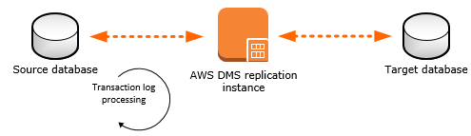
AWS Database Migration Service
AWS DMS creates the tables and associated primary keys if they don't exist on target.
You can pre-create the target table manually or you can use AWS schema Conversion Tool (SCT) to create some or all the target tables, indexes, views, triggers, etc.

Slide 9



Type of AWS Database Migration Service
Support Homogenous Migration:
Source and target Database of same type, example from on-premise to cloud
On-Premise
Cloud
Support Heterogeneous Migration:
Source and target Database of different type, example from MySQL RDS to Aurora

Slide 10
Source & Targets
Source | Targets
On-Premises and Ec2 instance Databases: Oracle, MySQL, MariaDB, PostgreSQL, SAP, Db2, MongoDB, Microsoft SQL Server | On-Premises and Ec2 instance Databases: Oracle, MySQL, MariaDB, PostgreSQL, SAP, Microsoft SQL Server
Azure SQL Database | AWS RDS
Amazon RDS | Redshift
Amazon Aurora | DynamoDB
Amazon S3 | S3, Document-DB
 | Elasticsearch Service
 | Kinesis Data Stream

Slide 11
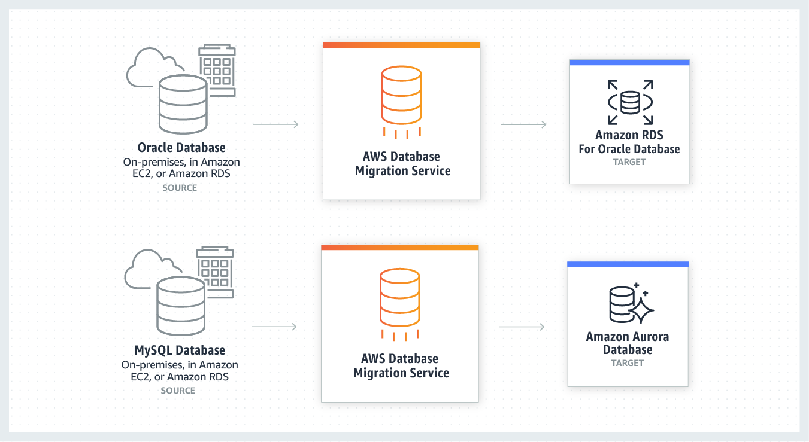
AWS Database Migration Service

Slide 12
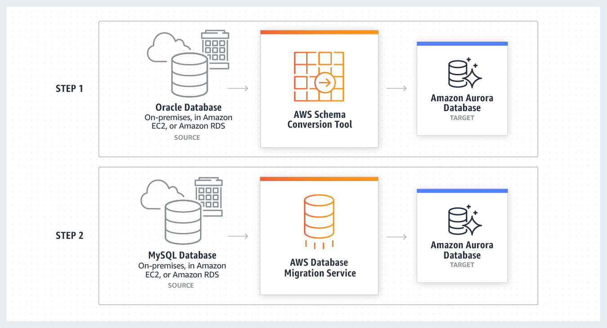
AWS Database Migration Service + Schema Conversion Tool

Slide 13

Exam Tips:
ElastiCache is an in-memory cache designed to improve read performance for read-heavy databases.
Memcached:
In-memory, key-value data store.
Object caching is your primary goal
You want to keep things as simple as possible
You don’t need persistence or Multi-AZ
You don’t need to support advanced data type or sorting
Redis:
In-memory, key-value data store.
You are performing data sorting and ranking, such as gaming leaderboards
You have advanced data type, such as lists and hashes
You need data persistence
You need Multi-AZ

Slide 14
Exam Tips:
DMS allows you to migrate databases from on source to AWS.
The source can either be on-premises or inside AWS itself or another cloud provider such as Azure.
You can do homogenous migrations (same DB engine) or heterogenous migrations.
If you do a heterogenous migrations, you will need the AWS schema Conversion Tools (SCT)

Slide 15
Thank you

